Slide 1
Choosing the ny best holiday stay

Slide 2
Choosing our desires
Generally when choosing a trip, voyagers try to stay at calm places while they are near to visit interesting places BUT, the Price of the residence is a general research among visitors world wide.
So in a trip research you must look for an interesting place to go, a way to make it cheap and try to make it safe.
For this reasons, our research will be centered in the city of New york and will be focused in 2 main points:
Price of airbnbs
Neighbourhood security

Slide 3
Data acquisition and cleaning
Airbnb pricing with it’s location csv:
https://www.kaggle.com/dgomonov/new-york-city-airbnb-open-data/
Criminality per neighbourhood csv:
https://data.world/data-society/nyc-crime-data

Slide 4
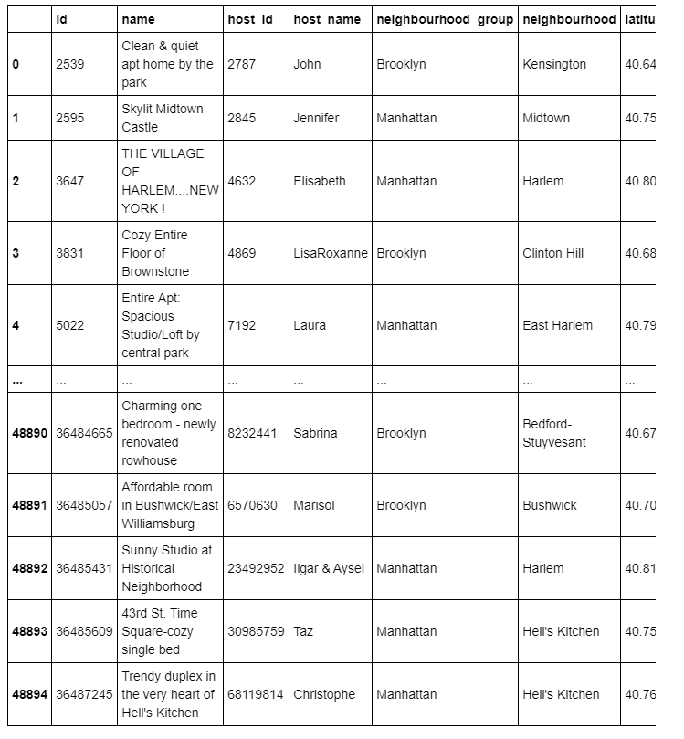
First we get the table of airbnbs

Slide 5
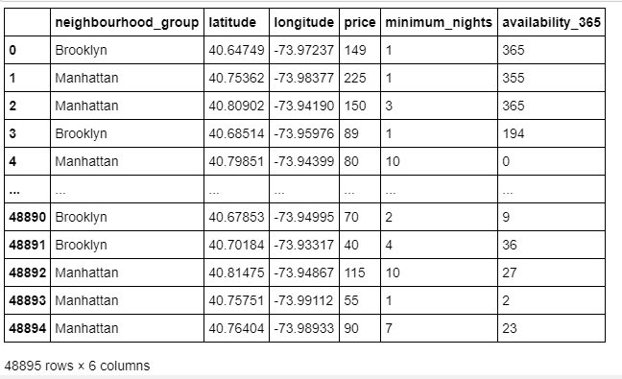
Then we drop the unnecesary data

Slide 6
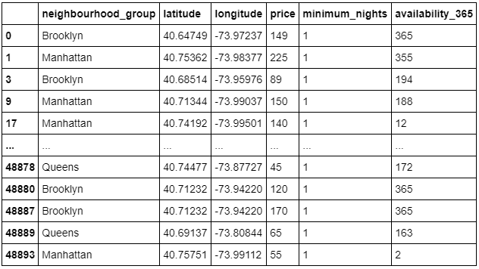
Filtering min nights

Slide 7
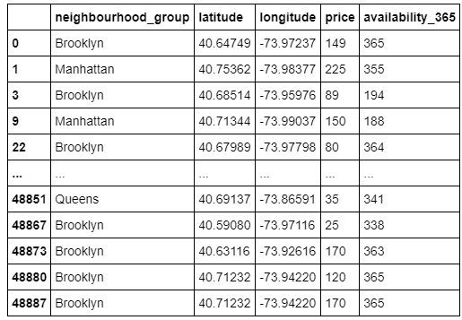
And assuring availability

Slide 8
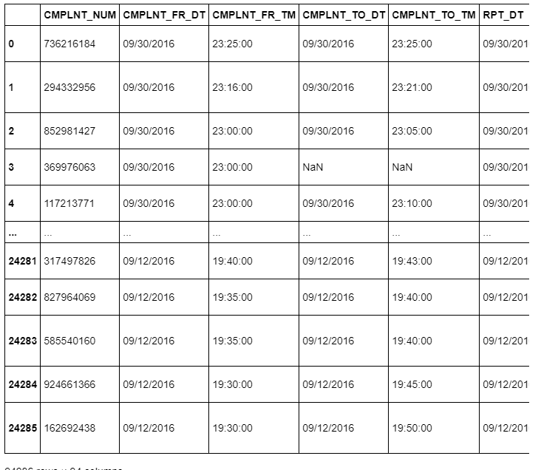
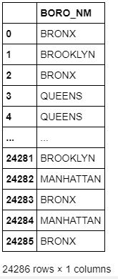
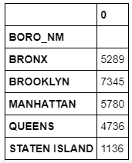
Now from the criminality we get the crime intensity

Slide 9
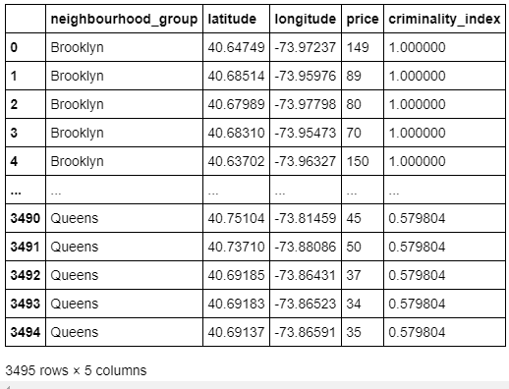
After normalization of crime intensity and merging tables we get this

Slide 10
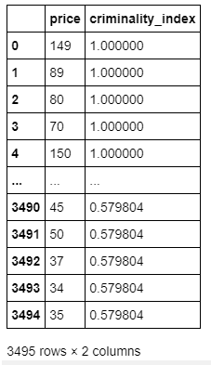
We Will fit the model with Price and criminality index from this

Slide 11
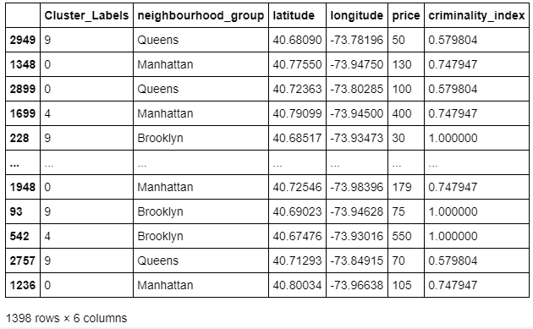
Then we get the cluster labels for each Airbnb. Due to excessive data we select arbitrarly an 40% of the samples
arbitrarily

Slide 12
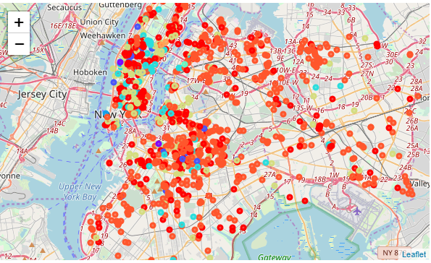
As final result we conclude with the best área being manhattan as seen in the picture

